Slide 1
Improving Windows Workflows For Development
Alex Howson

Slide 2



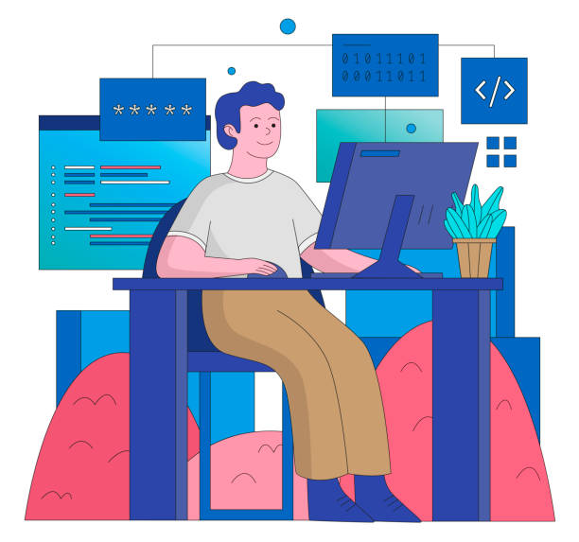
Agenda
Default Applications
Package Management
Terminal Application
Terminal Multiplexer
Virtual Desktops/ Workspaces

Slide 3

Windows
Default Applications

Slide 4
User Experience vs Default Experience
Notes:
Talk about Microsoft, Google and Apple ecosystems and how the default isn’t necessarily what the user wants

Slide 5
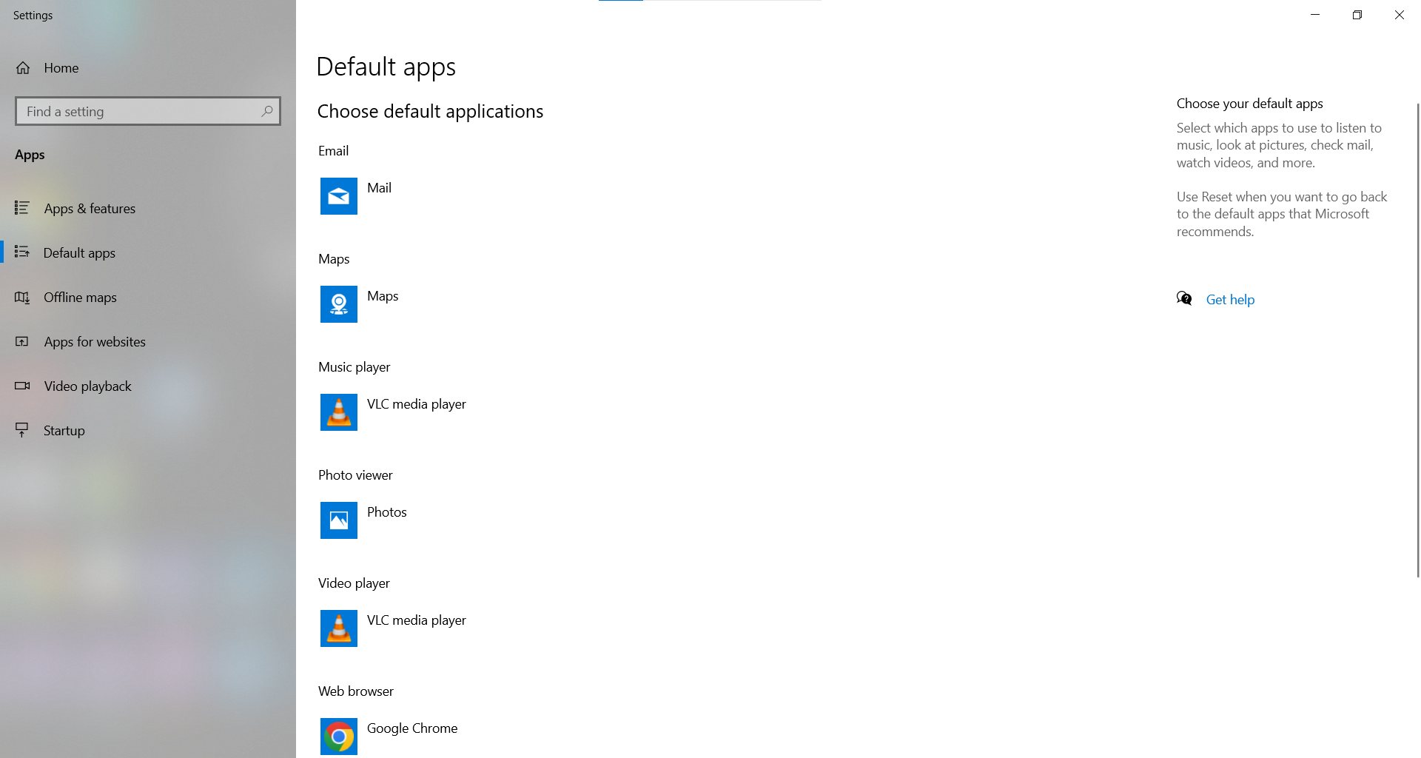
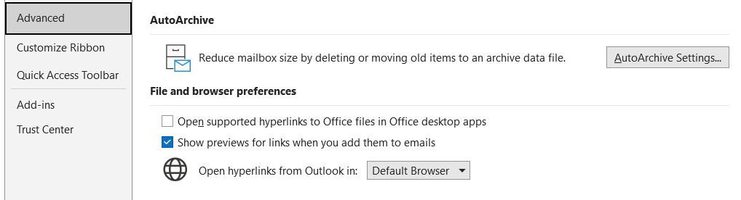
Tailor Your User Experience
Change default applications to the ones you use

Slide 6
“Fit the applications you choose to your workflow. Don’t accept the default”
Some Developer Probably

Slide 7
Package Management
Chocolatey

Slide 8
Automate Application Upgrades
The default experience of upgrading applications on windows is slow.
What if there was a better way of handling application releases…

Slide 9
Chocolatey
Chocolatey is what is known as a “package manager”.
A package manager contains a repository of application versions that it compares with your system’s application versions.
It can perform a variety of functions through commands such as upgrading, downgrading, locking a version, installing applications, uninstalling applications and so on.
https://chocolatey.org/why-chocolatey

Slide 10
“Save time by automating repetitive processes”
Sun Tzu Said (Probably)

Slide 11
Terminal Application
Alacritty

Slide 12
Alacritty
Alacritty is a rust powered terminal that is hardware accelerated terminal application.
It is highly configurable using a “alacritty.yml” configuration file stored in “%APPDATA%/alacritty/alacritty.yml”.
The configuration supports different shells, multiplexers (terminal tabs), themes, font sizes and style as well as a default folder to open in.
Most importantly it is really fast and responsive.

Slide 13
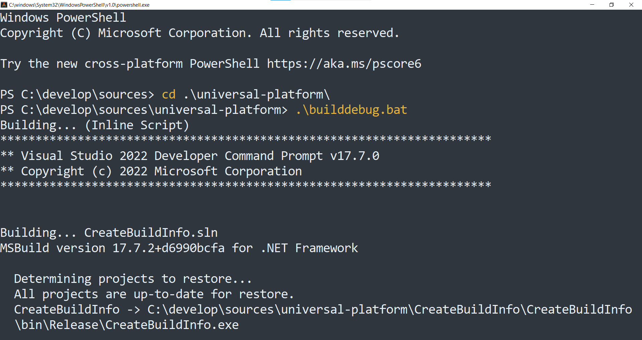
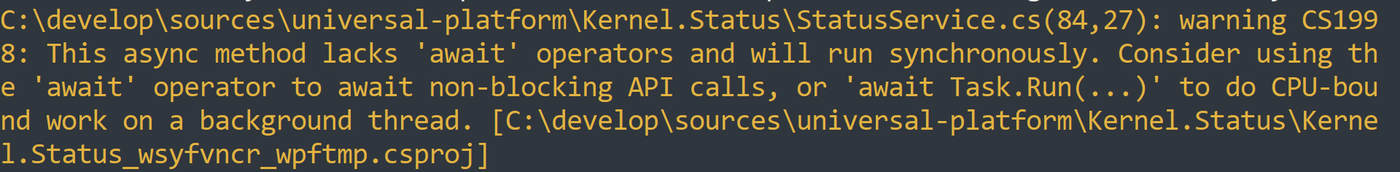
Example

Slide 14

Terminal Multiplexer
Zellij

Slide 15
Zellij Multiplexer
Zellij is a rust powered (very fast) multiplexer that can be added to Alacritty through the configuration file
Multiplexers allow for one terminal program running with multiple tabs/ panes etc (like a web browser)
This is another means of improving your workflow
Note: Alacritty by default doesn’t come with a multiplexer

Slide 16
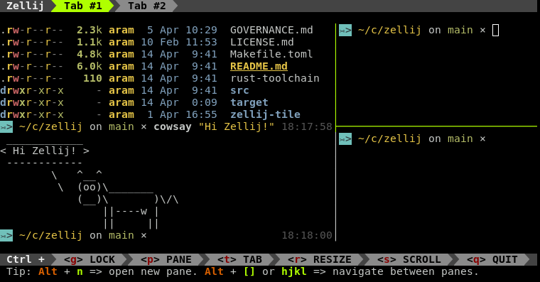
Example

Slide 17
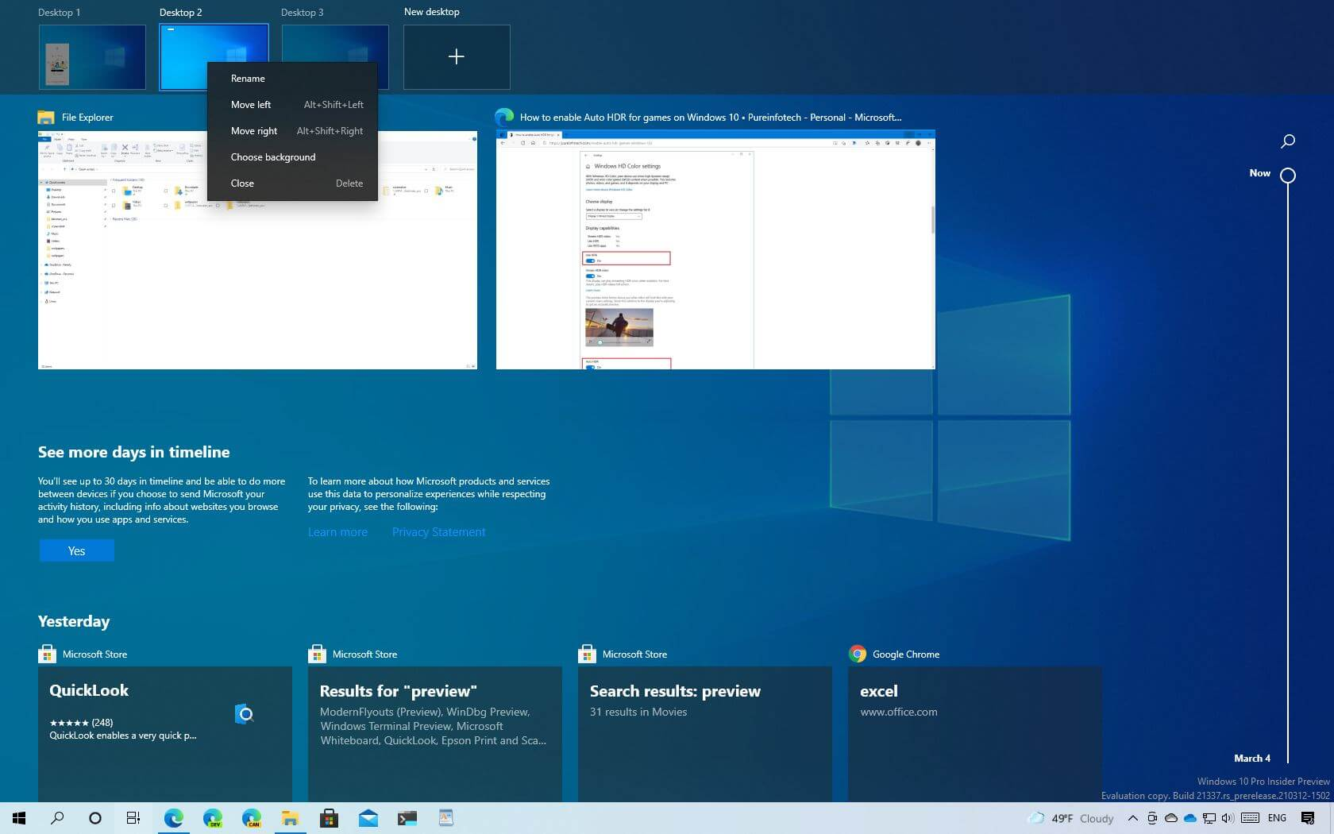
Virtual Desktop/ Workspaces
Windows Virtual Desktops

Slide 18
Virtual Desktop
Virtual desktops is a useful power user feature of Windows 10/ 11
Virtual desktops allow for groups of applications to be clustered together and quickly switched between.

Slide 19
Setup
To setup virtual desktops press “win+tab” then click add desktop
In here you can search for activities using “ctrl+f”
Drag the applications across to the new desktop
Switch between desktops using “ctrl+win+←/→”
Create a virtual desktop with “ctrl+win+d”
Close a virtual desktop with “ctrl+win+F4”

Slide 20
Example

Slide 21
Recommendations
Don’t go over three virtual desktops as it gets hard to manage
Try keeping at two applications per virtual desktop for quick “alt+tab”
Keep the main application you want to use on top
Keep the layout consistent so it becomes muscle memory when navigating. For example, browser on the right screen, IDE middle screen, tortoise git left screen.

Slide 22
Don’t accept the default user experience Automate repetitive tasks Use performant utilities Optimise your workflow
Summary

Slide 23
Links
Defaults: http://wilma:8090/display/SOF/Change+Outlook%27s+Default+Web+Browser
Package Management: http://wilma:8090/display/SOF/Package+Management+For+Windows
Virtual Desktops: http://wilma:8090/display/SOF/Windows+10+Workflow+For+Power+Users
Alacritty: http://wilma:8090/display/SOF/Alacritty+A+Better+Terminal+Application
Zellij: (Guide in progress)

Slide 24
Thank you
Alex Howson

